Slide 1
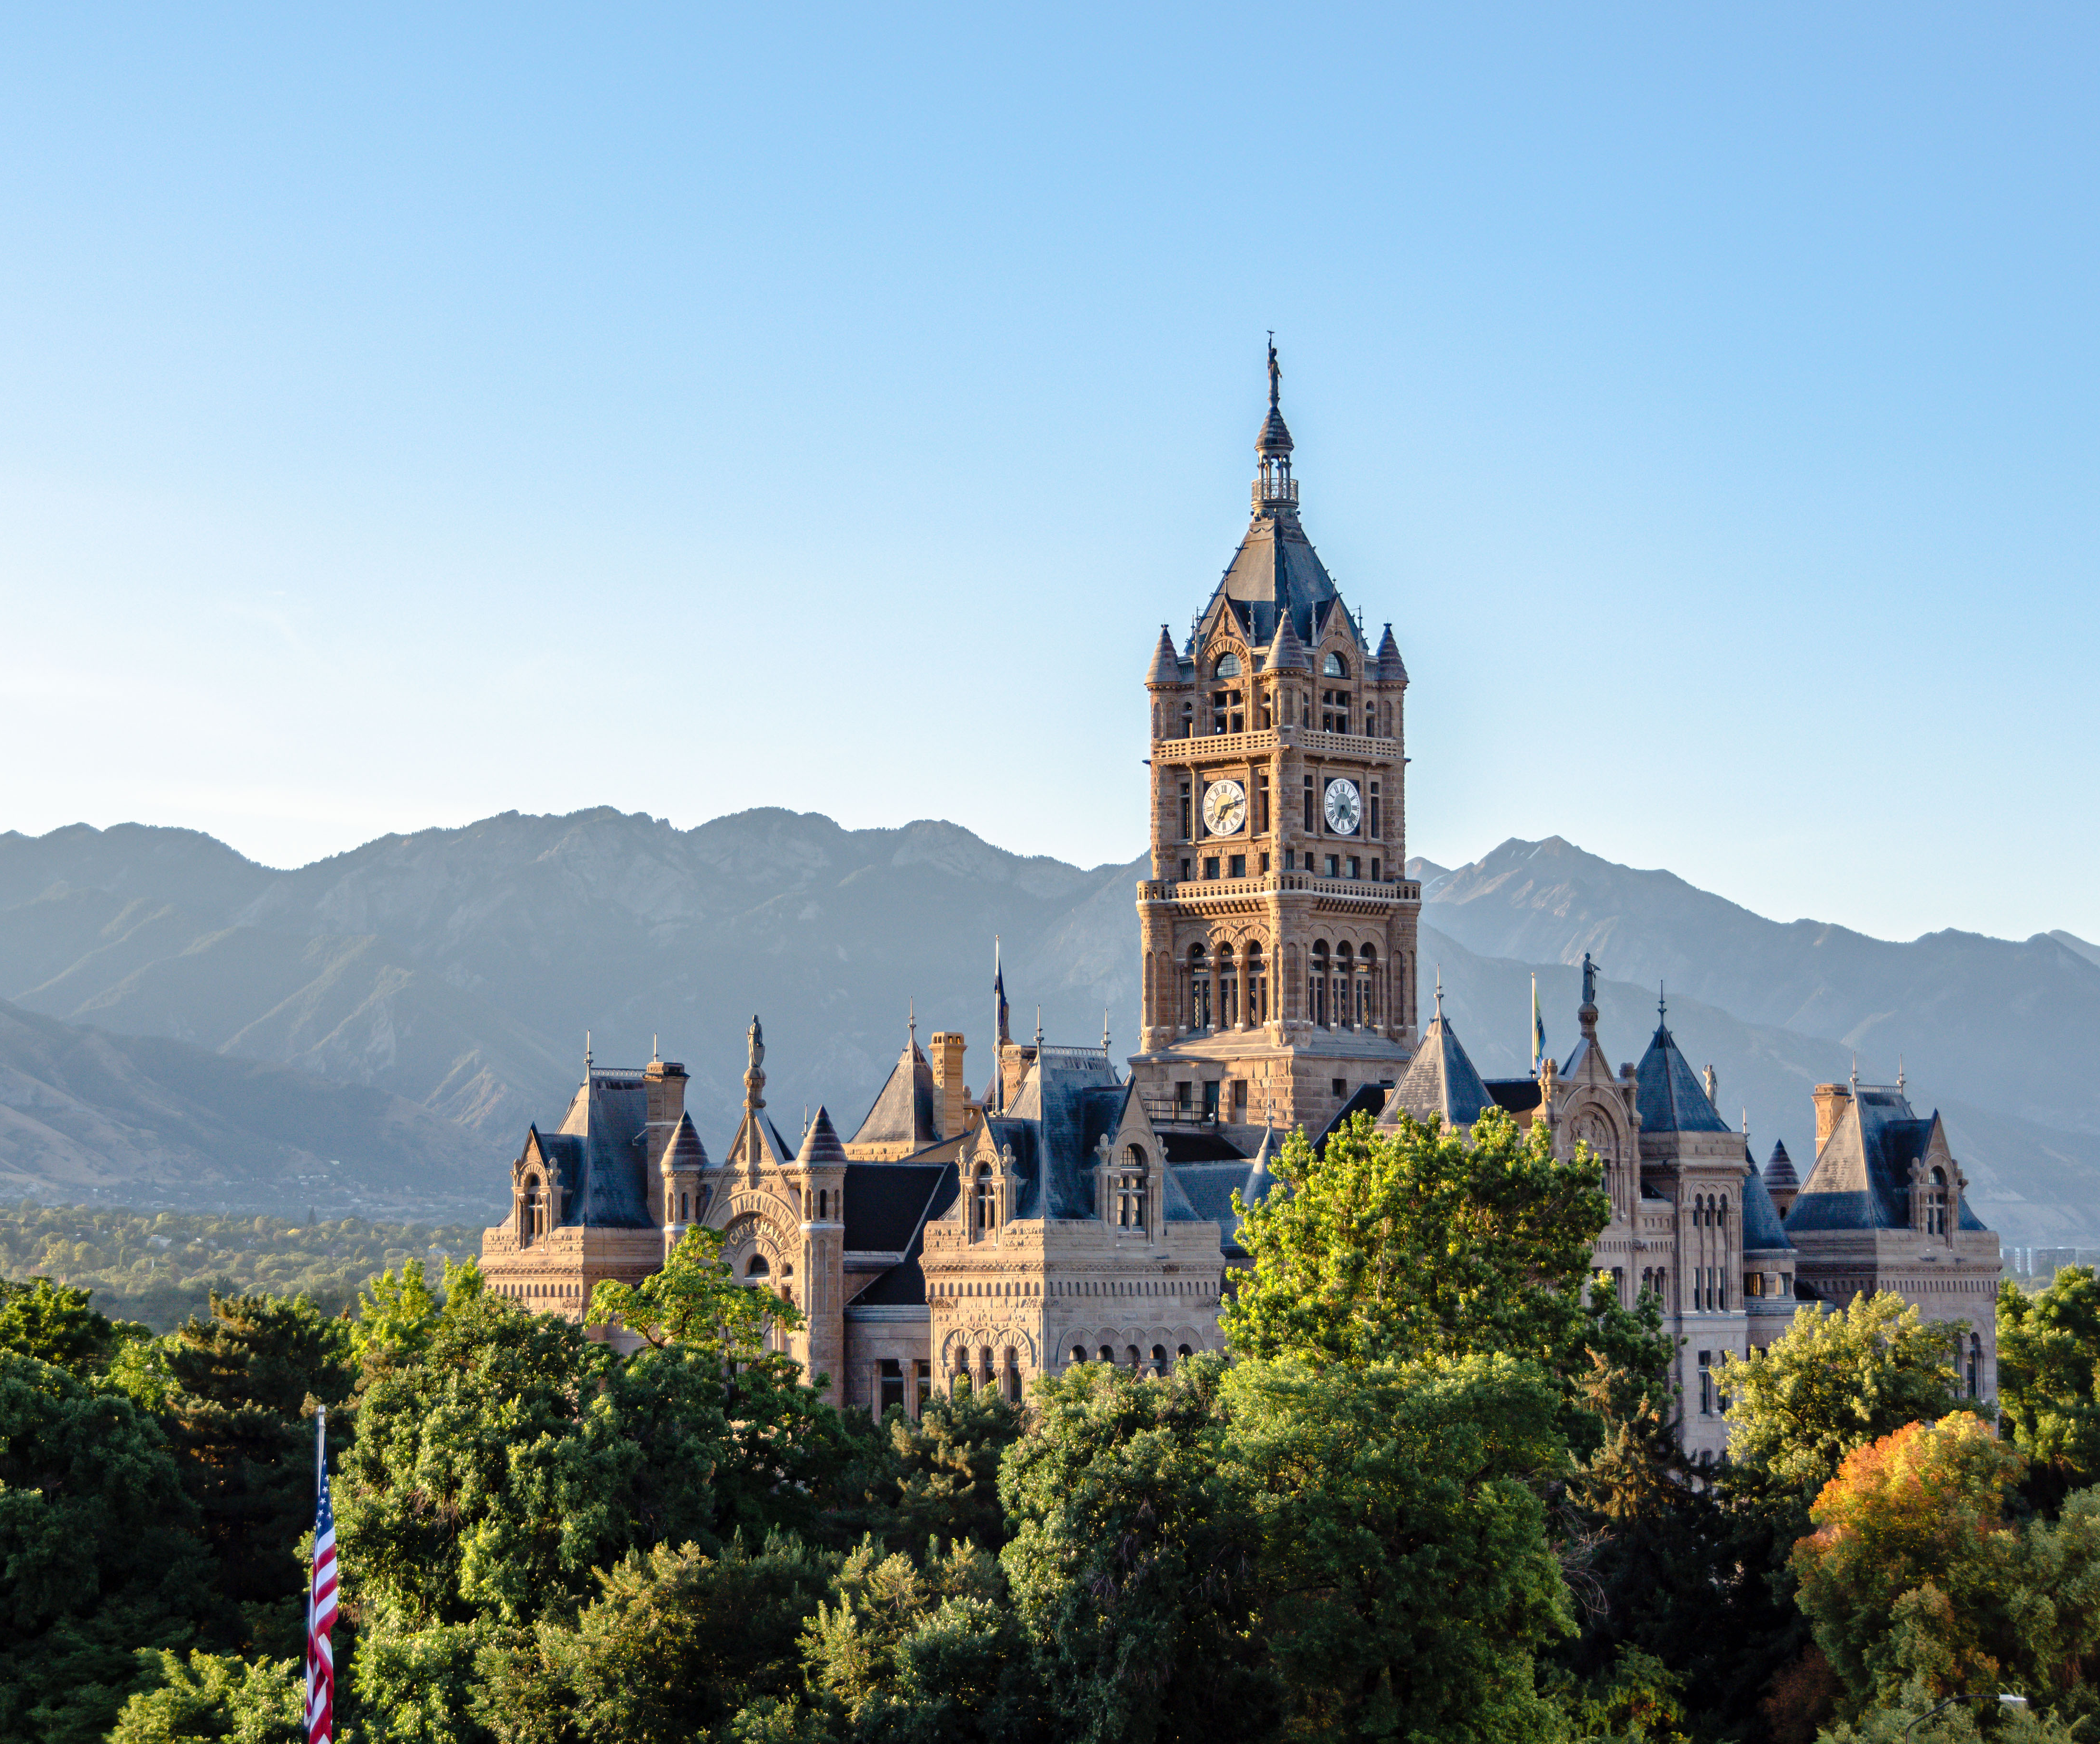

Mayor’s
Update
July 17, 2024

Slide 2

Sunnyside Traffic Impacts
Construction has begun on the underground utilities for the University housing on Foothill and Sunnyside.
For 10 weeks, traffic will be reduced to one lane in each direction and the speed limit will be reduced to 15 MPH. The bike lane will become a shared lane with vehicles.
The work will be done in phases, starting at 1800 E, moving east.
Questions or concerns:
  Sherri Somers, Construction Project Manager, University of Utah
  801-585-5826
  sherri.somers@utah.edu

Slide 3
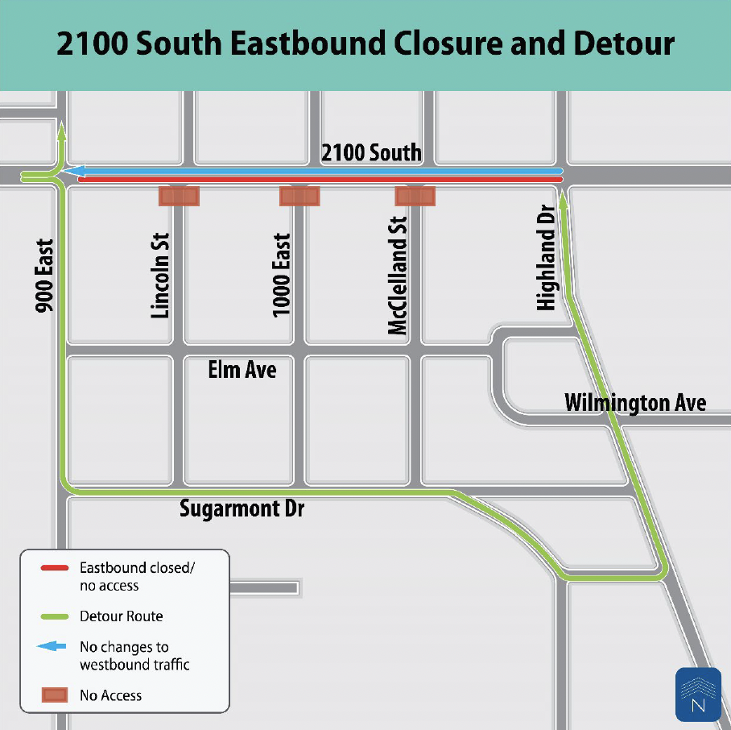
2100 South Closure Information
The 2100 South Road Reconstruction project underway in Sugar House requires westbound-only traffic for two blocks from until mid-August.
The eastbound lane between 900 and 1100 East will be closed for construction crews; westbound traffic will continue as usual.
Highland Drive has been temporarily opened back up to two-way traffic to make it easier to access local businesses.
Eat lunch in Sugarhouse!

Slide 4
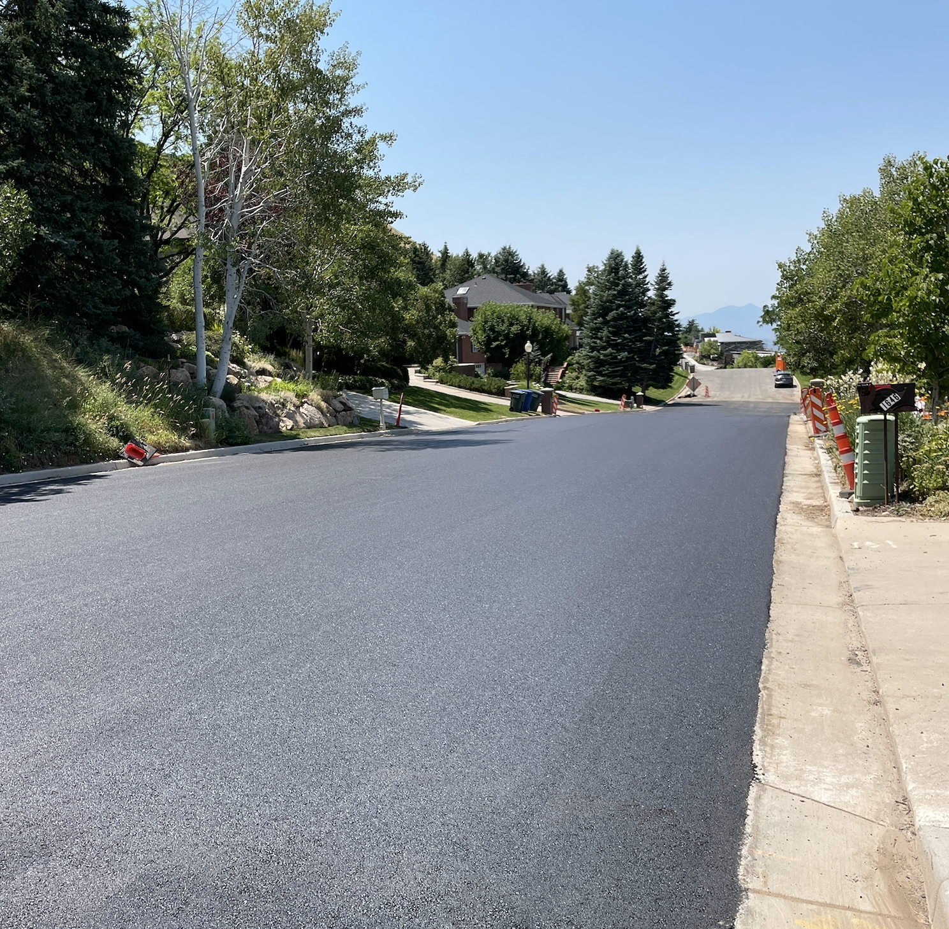
Local Streets Construction
Devonshire Dr: Paved last week. Remaining work is to pave concrete collars to raise manholes to grade.
Kensington Ave: Crews are working on a slurry treatment to provide a solid base for the road. Paving is planned for July 25th
Oquirrh Dr: All concrete work will be completed today. Crews will start the reclaimed aggregate process tomorrow, which will last about 2 weeks, then move on to paving.
Questions?
LocalStreets@slcgov.com
801-535-6666

Slide 5
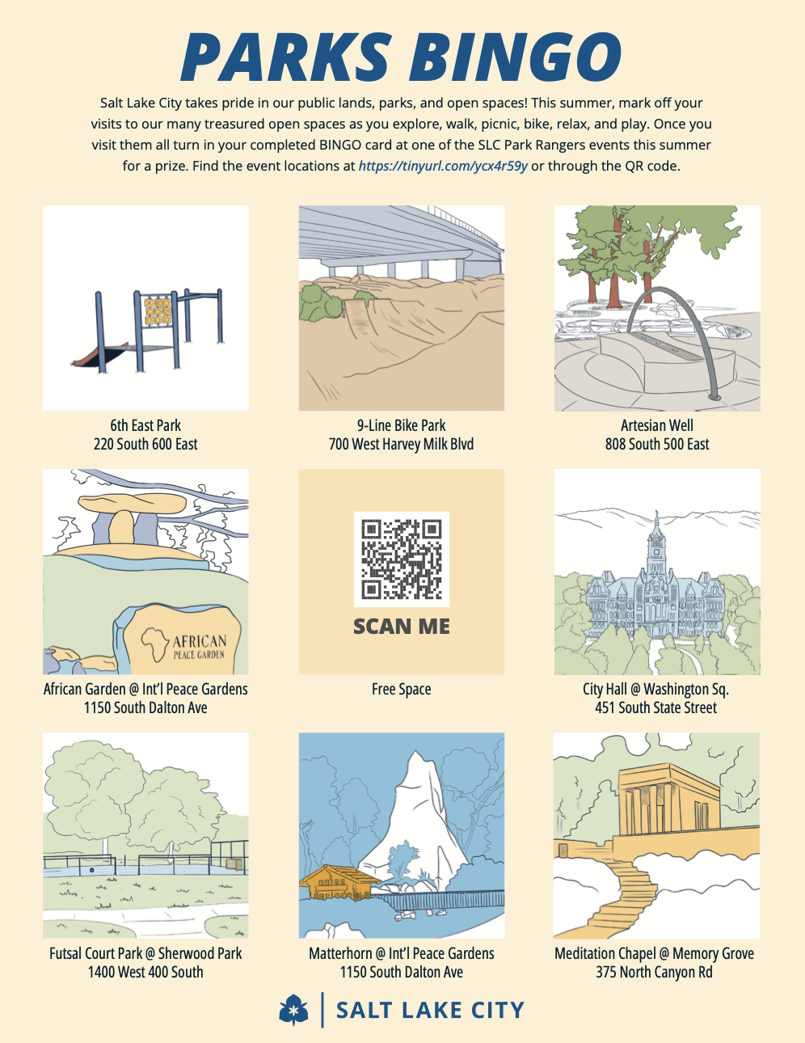
Parks Bingo
The Mayor’s Office has created some Parks BINGO cards for the summer to encourage Salt Lakers to get out into our parks and green spaces.
Once the cards are complete (blackout style), take them to our Park Rangers in Liberty Park, Fairmont Park, Jordan Park, or Pioneer Park for a prize!

Slide 6
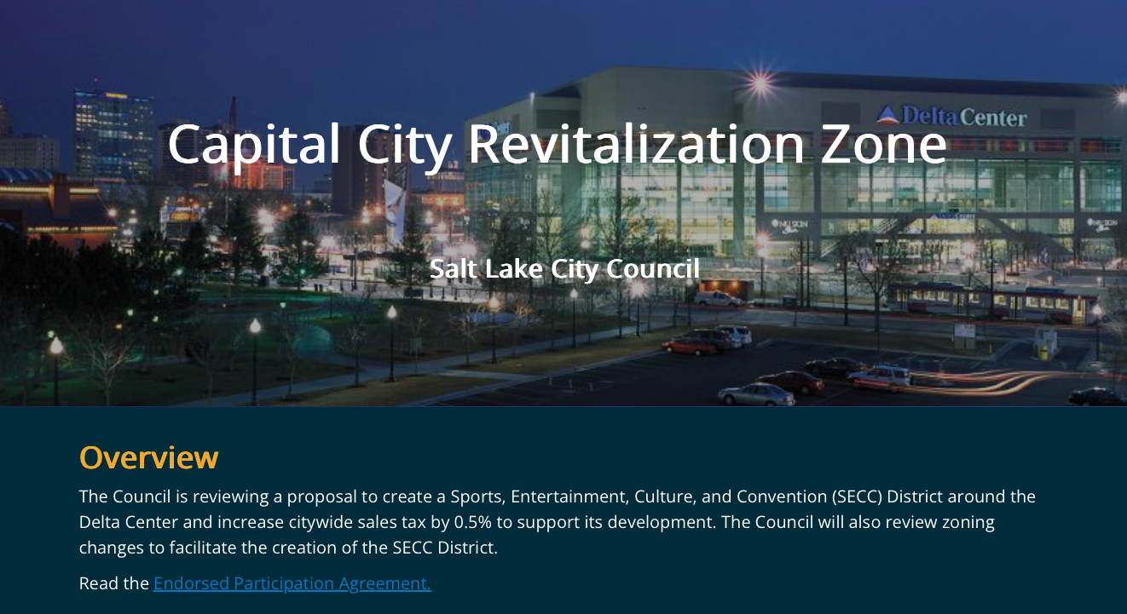
Capital City Revitalization Zone Website
https://capital-city-revitalization-zone-slcgov.hub.arcgis.com

Slide 7
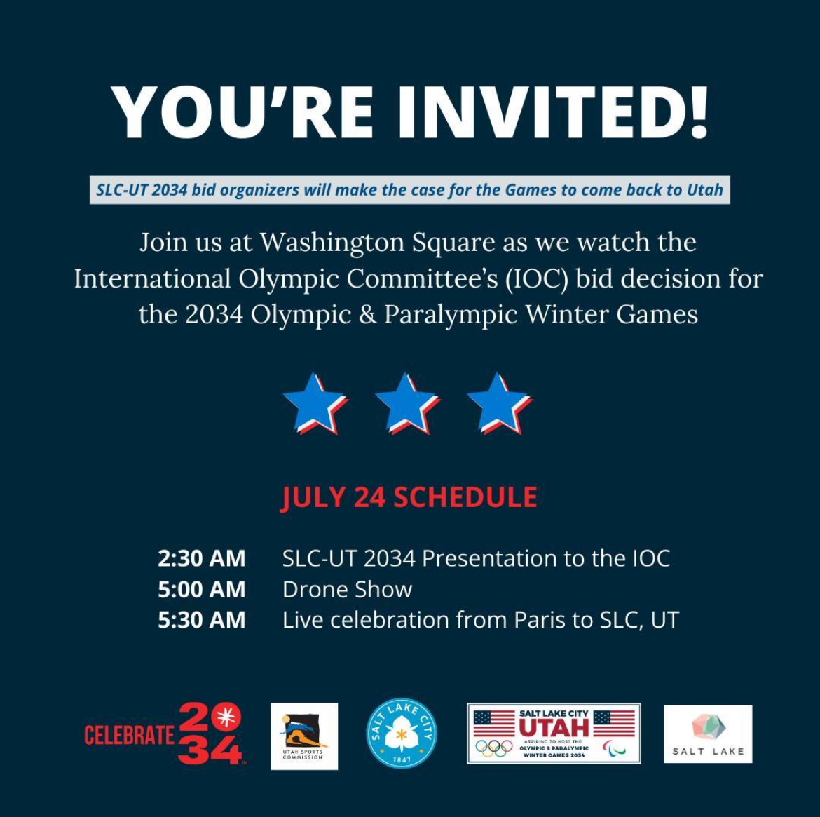
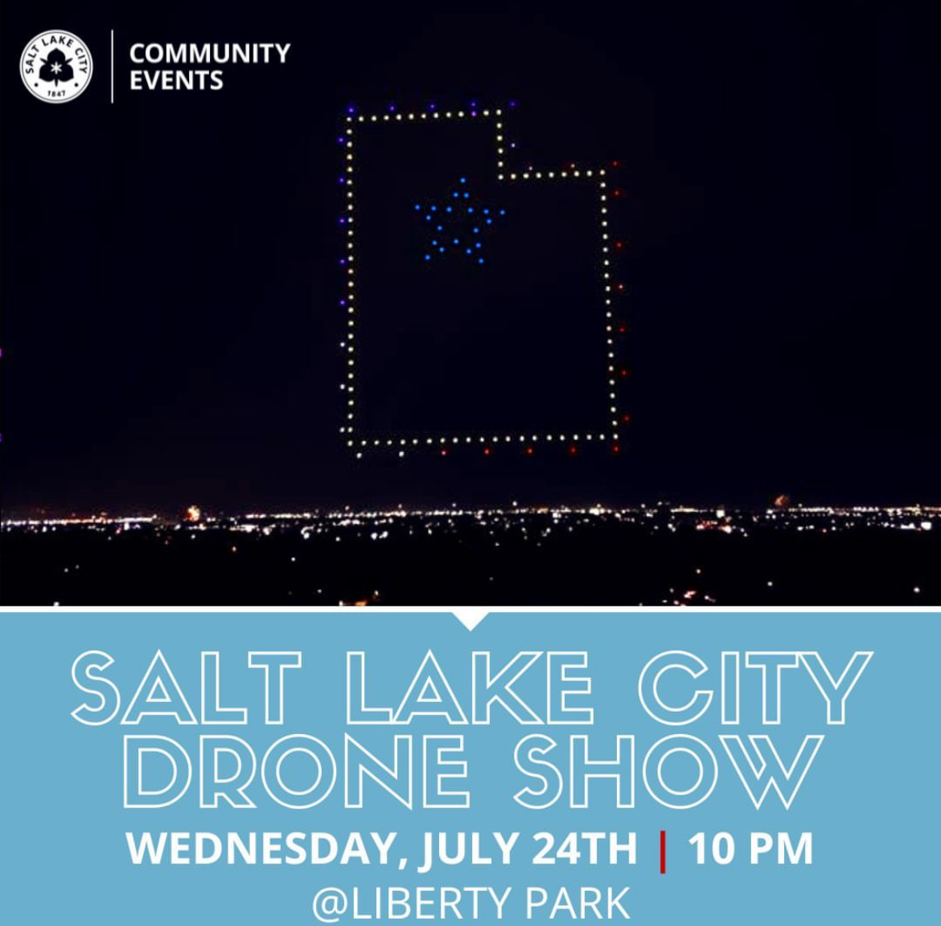
Olympics & Pioneer Day Events

Slide 8
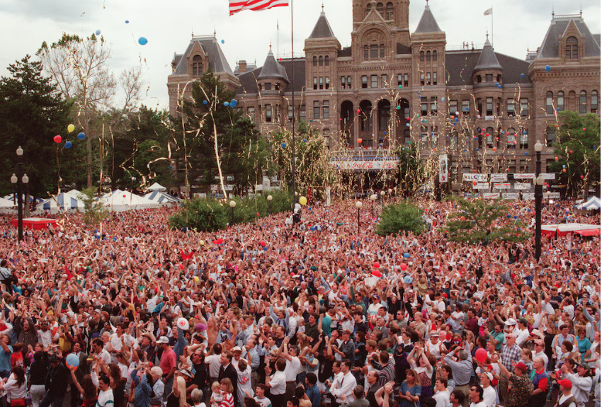
1995 Inspiration

Slide 9
Thank you!
Community Liaison Contact information: HANNAH BARTON Community Liaison, Districts 6 & 7
OFFICE of the MAYOR | SALT LAKE CITY
Office: (801) 535-6592| Mobile: (385) 258-8503
Email: Hannah.Barton@slcgov.com

